Slide 1
N. Rizk
COSC 3337 : Data Science I
College of Natural and Applied Sciences
Department of Computer Science
University of Houston

Slide 2
α
Linear Classifiers
x
f
y^{est}
f(x,β₁,β₀) = sign(β₁x + β₀)
denotes +1
denotes -1
β₁x + β₀ >0
β₁x + β₀ =0
How would you classify this data?
β₁x + β₀<0

Slide 3
α
Linear Classifiers -> to find a Betas
x
f
y^{est}
f(x,β₁,β₀) = sign(β₁x + β₀)
denotes +1
denotes -1
Apply for job
ABC for Data Mining
How would you classify this data?

Slide 4
α
Linear Classifiers
x
f
y^{est}
f(x,β₁,β₀) = sign(β₁x + β₀)
denotes +1
denotes -1
How would you classify this data?

Slide 5
α
Linear Classifiers
x
f
y^{est}
f(x,β₁,β₀) = sign(β₁x + β₀)
denotes +1
denotes -1
Any of these would be fine..
..but which is best?

Slide 6
α
Linear Classifiers
x
f
y^{est}
f(x,β₁,β₀) = sign(β₁x + β₀)
denotes +1
denotes -1
How would you classify this data?
How many errors do we have?
Misclassified
to +1 class

Slide 7
α
α
Classifier Margin
Classifier Margin
x
x
f
f
y^{est}
y^{est}
f(x,β₁,β₀) = sign(β₁x + β₀)
denotes +1
denotes -1
denotes +1
denotes -1
Define the margin of a linear classifier as the width that the boundary could be increased by before hitting a datapoint.
Define the margin of a linear classifier as the width that the boundary could be increased by before hitting a datapoint.
SVM based on the Margin
ADVANTAGE: how far each class .
What it does?

Slide 8
α
Maximum Margin
x
f
y^{est}
Linear SVM
f(x,β₁,β₀) = sign(β₁x + β₀)
denotes +1
denotes -1
The maximum margin linear classifier is the linear classifier with the, um, maximum margin.
This is the simplest kind of SVM (Called an LSVM)
Support Vectors are those datapoints that the margin pushes up against
Maximizing the margin is good according to intuition and PAC theory
Implies that only support vectors are important; other training examples are ignorable.
Empirically it works very well.

Slide 9
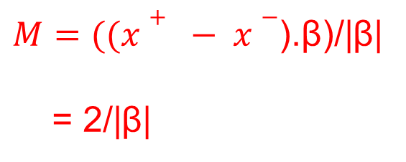
Linear SVM Mathematically
x⁺
M=Margin Width
“Predict Class = +1” zone
X⁻
β₁x + β₀ =1
“Predict Class = -1” zone
β₁x + β₀ =0
β₁x + β₀ =-1
What we know:
β₁x ⁺ + β₀ = +1
β₁x + β₀ = -1
β₁ . (x⁺-x⁻⁾ = 2

Slide 10
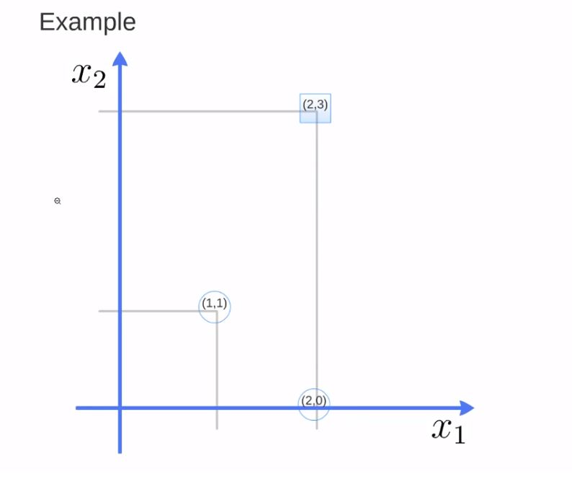
Width =(x⁺ - X⁻).β / ‖β‖
Linear SVM
Beta divided by magnitude to get the unit vector
x⁺
x⁺ - X⁻
→
β (a,2a)=(2,3)-(1,1)
Unit vector
g(1,1)=-1=a+2a+ β₀ =-1
g(2,3)=1=2a+6a+ β₀ =1
a=2/5; β₀ =11/5
g(x)=2/5 x₁ +4/5 x₂-11/5
g(x) = x₁ +2 x₂-5.5
X⁻
→
β (2/5,4/5)=(2,3)-(1,1)
UNIT VECTOR == SVM

Slide 11
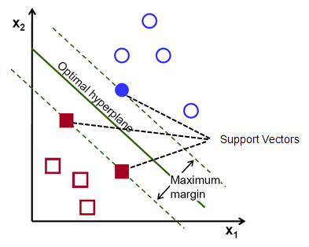

Slide 12
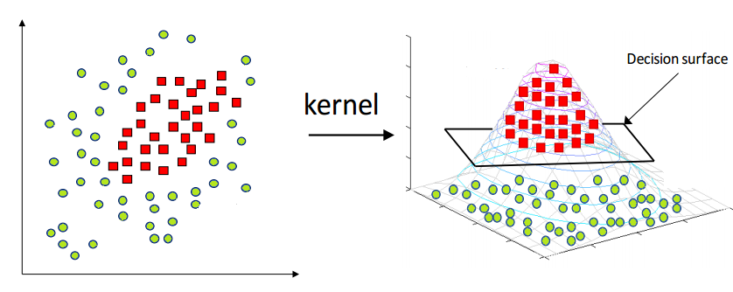
φ
Function to map the data (transform ) from 2-dimensional space to 3-dimensional space, we will be able to find a decision surface that clearly divides between different classes. Find the boundary, and make the classification.
THE BIGGEST ADVANTAGE can transform any Dimensions 2D- to 3D. Simulate Dimension

Slide 13
Non-linear SVMs: Feature spaces
General idea: the original input space can always be mapped to some higher-dimensional feature space where the training set is separable:
Φ: x → φ(x)
Have to apply function. does it automatically

Slide 14
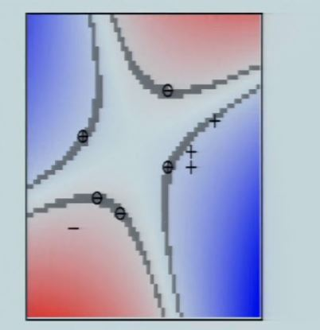

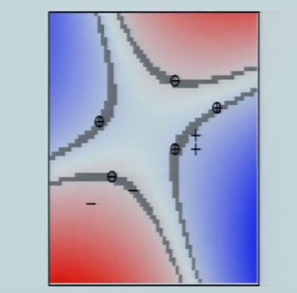
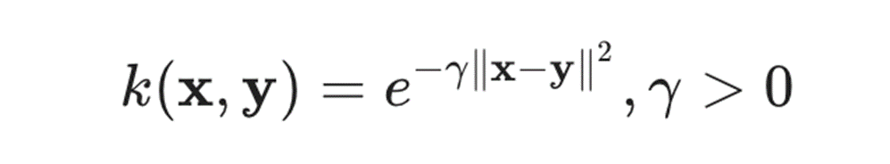
Kernel allows us to operate in the original feature space without computing the coordinates of the data in a higher dimensional space.
Need to optimize a kernel function
k(x_{i} , y_{i})=φ(x_{i} ).φ (y_{i})
A kernel choice can be
What is the Cornal? It is a Projection

Slide 15
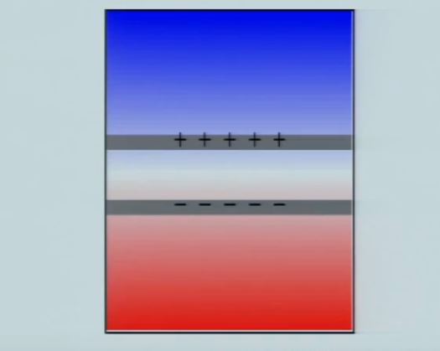
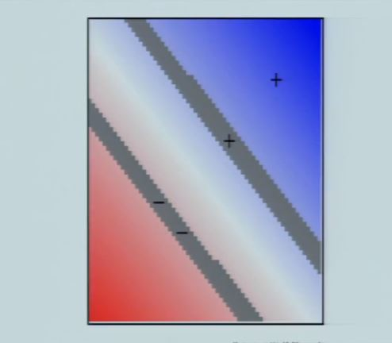
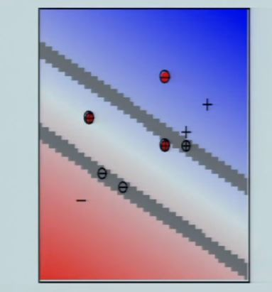
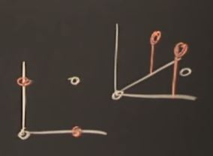
How do you know when to use Kernel ? When you have a lot of errors and when you can not split it
Points are not linearly separable 🡺
Need of transformation in another space

Slide 16
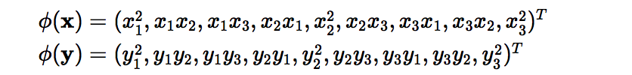
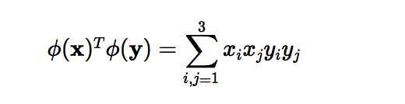
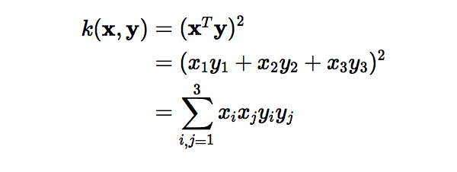
Instead of…..
Transform to 9th dimension
Kernel’s Role
instead of doing the complicated computations in the 9-dimensional space, we reach the same result within the 3-dimensional space by calculating the dot product of x -transpose and y

Slide 17

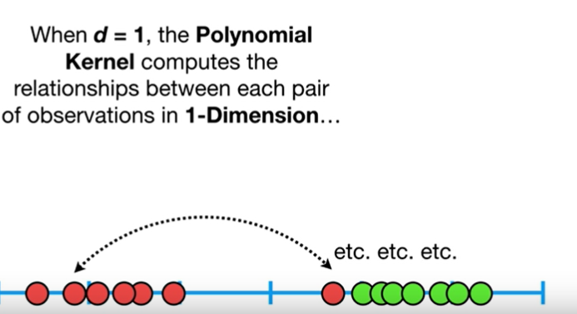
The polynomial kernel
The polynomial kernel: With n original features and d degrees of polynomial, the polynomial kernel yields n^d expanded features.
These relationships are used
to find the support vector classifiers
Good value of d can be found using
cross validation
We have one error. it is 1-D after projection

Slide 18
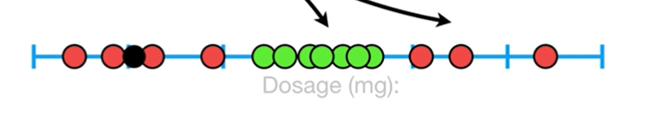
Gaussian Kernel RBF
The Radial Basis Function (RBF) kernel is also called the Gaussian kernel: The γ parameter defines how much influence a single training example has. It behaves like KNN the closer the more influence on the classification.
You will see it a lot in Python. Polynomial gives us 1 error
RBF works with KNN
Each Kernel gives difference evaluations

Slide 19
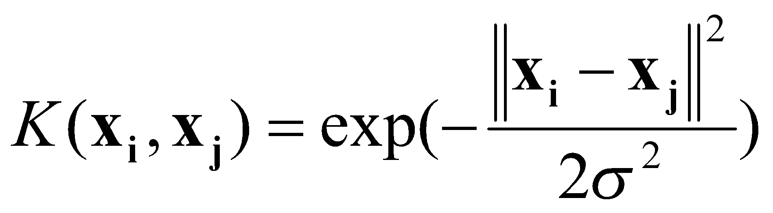
Examples of Kernel Functions
Linear: K(x_{i},x_{j})= x_{i} ^{T}x_{j}
Polynomial of power p: K(x_{i},x_{j})= (1+ x_{i} ^{T}x_{j})^{p}
Gaussian (radial-basis function network):
Sigmoid: K(x_{i},x_{j})= tanh(β₀x_{i} ^{T}x_{j} + β₁)
How many Kernel do we have? we have 4 Kernel
To project to data

Slide 20
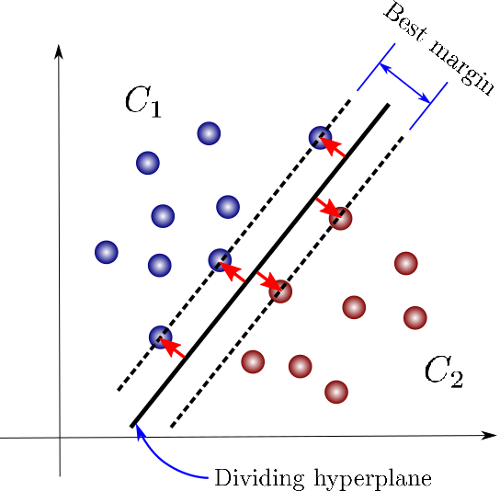
Hard Margin vs Soft vs Best Margin

Slide 21
Hard Margin …Dataset with noise
denotes +1
denotes -1
Hard Margin: So far we require all data points be classified correctly
- No training error
What if the training set is noisy?
- Solution 1: use very powerful kernels
DISADVANTAGE is OVERFITTING! it can wrongly classify
OVERFITTING!

Slide 22
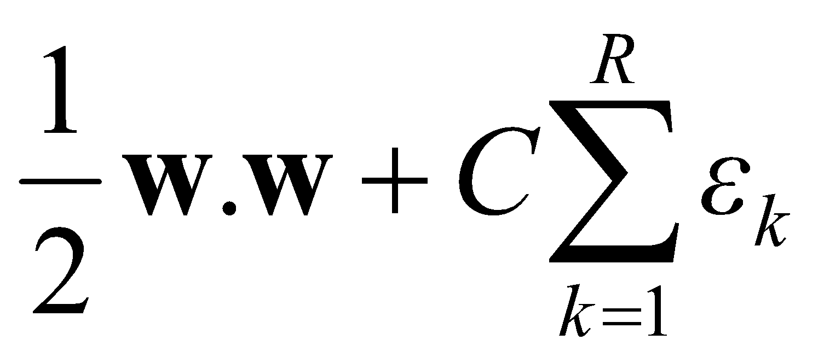
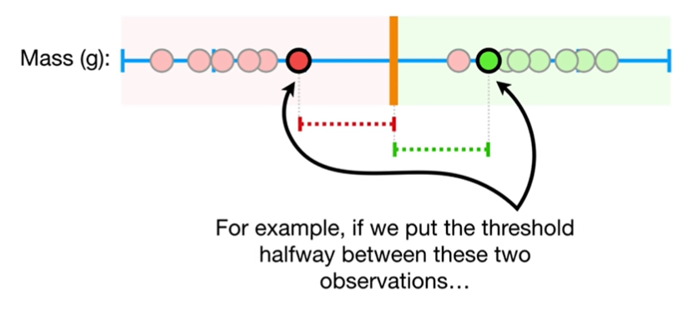
Soft Margin Classification
Slack variables ξi can be added to allow misclassification of difficult or noisy examples.
ε₁₁
What should our quadratic optimization criterion be?
Minimize
ε₂
wx+b=1
ε₇
wx+b=0
wx+b=-1
Soft margin here? SVM? Which one is the best way. It is acceptable error since it is in the mergin

Slide 23
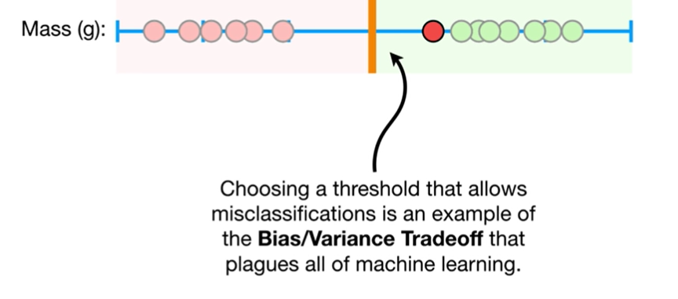

Slide 24
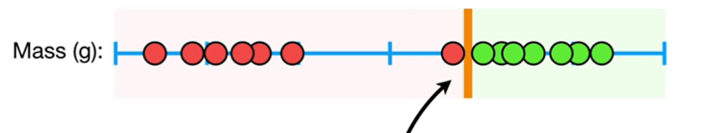
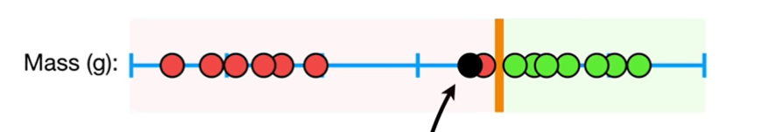
Threshold very sensitive to training data=>low bias
Performed poorly when we get new data=>high variance

Slide 25
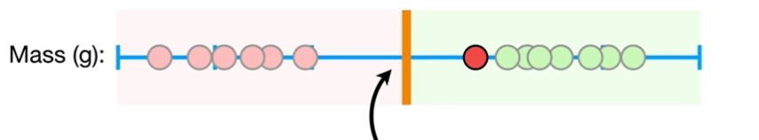
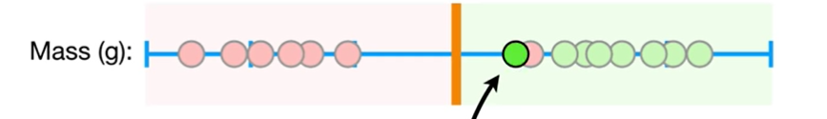
In contrast if we select a threshold ………..
Threshold less sensitive to training data and allow misclassifications =>High bias
Performed better when we get new data=>low variance
When we allow misclassifications the distance
is called SOFT MARGIN

Slide 26
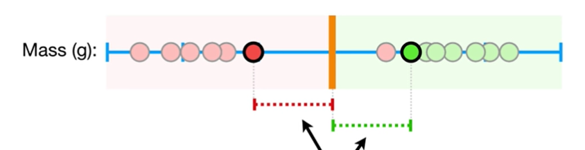
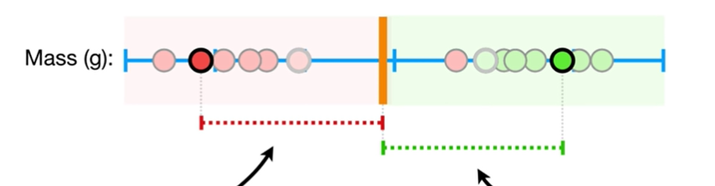
How do we find the best soft margin?

Slide 27
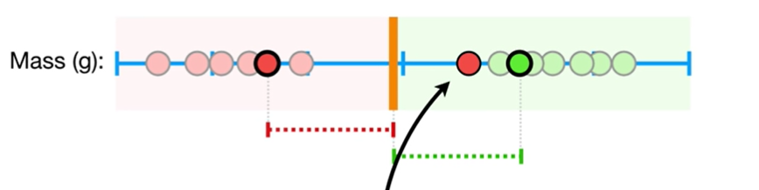
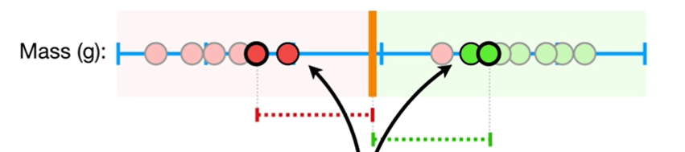
Cross validation
To find out the best threshold by determining how many
misclassifications and observations to be allowed
in the soft margin to get the best classifications
Allows 1 classification
Allows 2 correctly classified observations to be within the soft margin

Slide 28
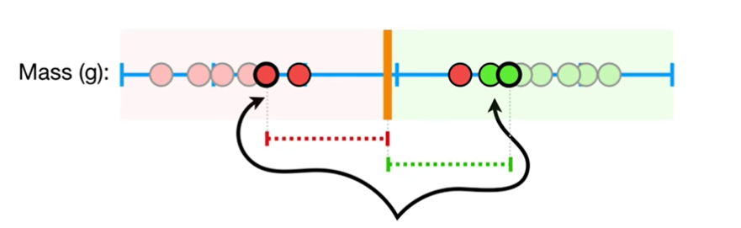
The correctly classified observations on the edge and within the soft margin are called support vector machine.

Slide 29
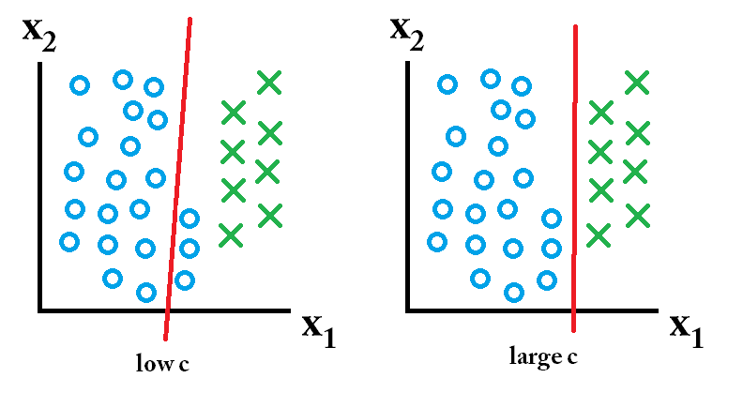
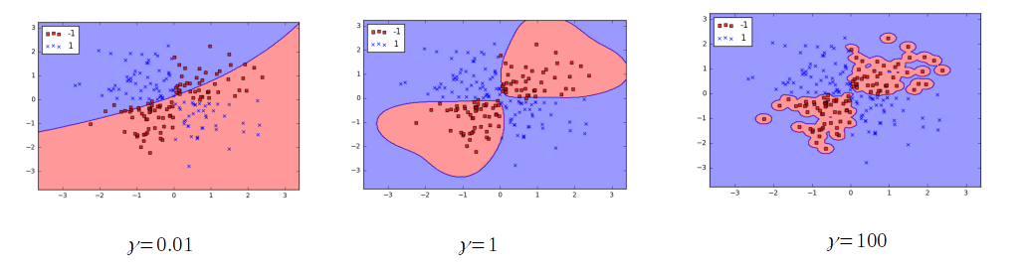
C vs Gamma
SVM( (C regularization (low ==>wide margin),
gamma how far the influence of a single training example reaches(low values ==> ‘far’))
C is the regulator, Gamma How many data you take. If C low you have a
Gamma<< we gonna consider all points

Slide 30
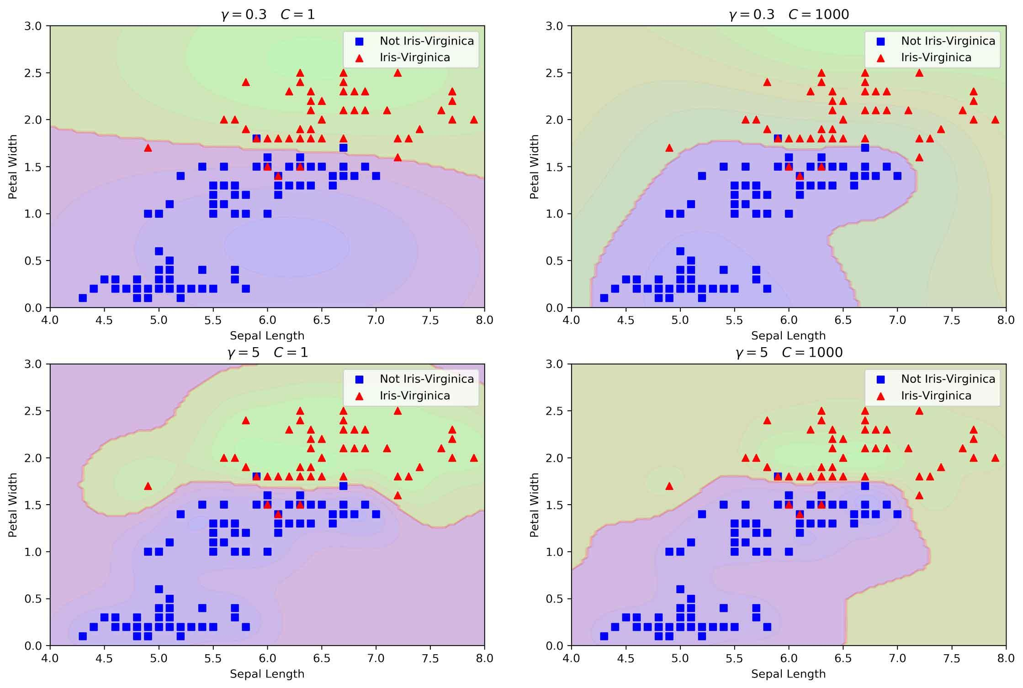
Low Gamma it means
If C is high what does it mean? there is not Soft margin then we do not have error
When C is very large, the soft-margin SVM is equivalent to hard-margin SVM. Too large means overfitting. Try to avoid Hard margin and large C.
When C is very small, misclassification in the training data at the expense of small norm

Slide 31
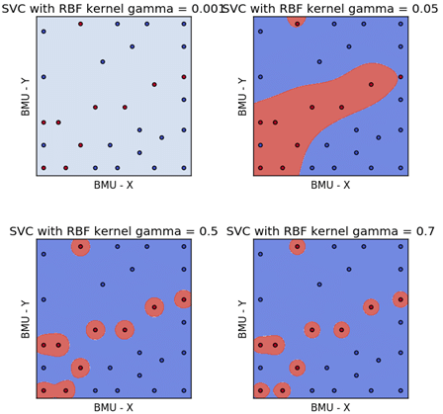
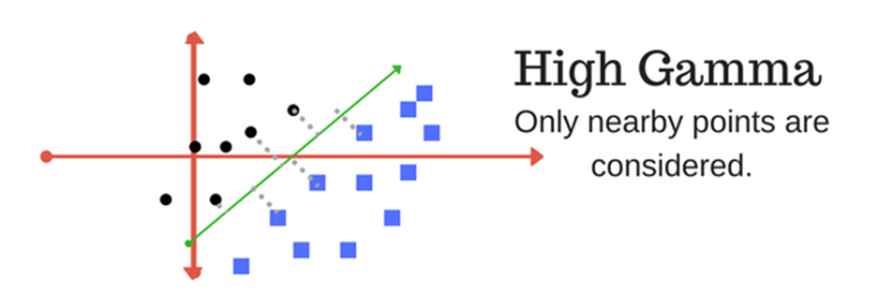
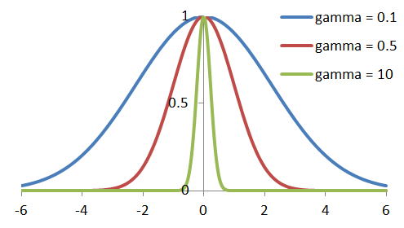
THe most popular is Gamma =0.1 (average)
DO not use big gamma

Slide 32
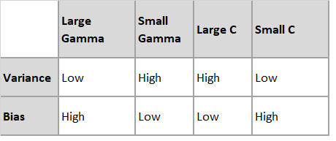
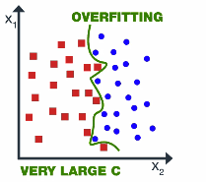
High value of Gamma leads to more accuracy but biased results and vice-versa.
A large value of Cost parameter (C) indicates poor accuracy but low bias and vice-versa.
Large Gamma close to the margin. Small Gamma variance is very high but bias is very low. Large C means hard margin.

Slide 33
Properties of SVM
Flexibility in choosing a similarity function
Sparseness of solution when dealing with large data sets
- only support vectors are used to specify the separating hyperplane
Ability to handle large feature spaces
- complexity does not depend on the dimensionality of the feature space
Overfitting can be controlled by soft margin approach
Nice math property: a simple convex optimization problem which is guaranteed to converge to a single global solution
Feature Selection
Why is popular? it is a parametric and can use with large features. you can control Overffiting by using soft margin

Slide 34
Some Issues
Choice of kernel
- Gaussian or polynomial kernel is default
- if ineffective, more elaborate kernels are needed
- domain experts can give assistance in formulating appropriate similarity measures
Choice of kernel parameters
- e.g. σ in Gaussian kernel
- σ is the distance between closest points with different classifications
- In the absence of reliable criteria, applications rely on the use of a validation set or cross-validation to set such parameters.
Optimization criterion – Hard margin v.s. Soft margin
- a lengthy series of experiments in which various parameters are tested

Slide 35
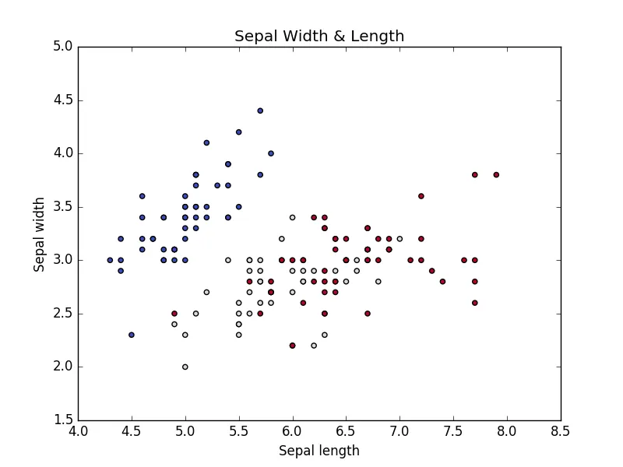
# Required Packages
from sklearn import datasets # To Get iris dataset
from sklearn import svm # To fit the svm classifier
import numpy as np
import matplotlib.pyplot as plt # To visuvalizing the data
# import iris data to model Svm classifier
iris_dataset = datasets.load_iris()
print "Iris data set Description :: ", iris_dataset['DESCR']
print "Iris feature data :: ", iris_dataset['data']
print "Iris target :: ", iris_dataset['target']
def visuvalize_sepal_data():
iris = datasets.load_iris()
X = iris.data[:, :2] # we only take the first two features.
y = iris.target
plt.scatter(X[:, 0], X[:, 1], c=y, cmap=plt.cm.coolwarm)
plt.xlabel('Sepal length')
plt.ylabel('Sepal width')
plt.title('Sepal Width & Length')
plt.show()
visuvalize_sepal_data()

Slide 36
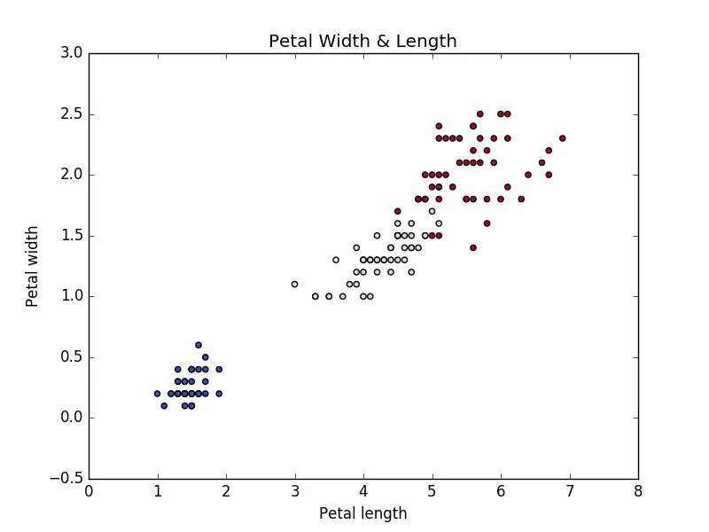
def visuvalize_petal_data():
iris = datasets.load_iris()
X = iris.data[:, 2:] # we only take the last two features.
y = iris.target
plt.scatter(X[:, 0], X[:, 1], c=y, cmap=plt.cm.coolwarm)
plt.xlabel('Petal length')
plt.ylabel('Petal width')
plt.title('Petal Width & Length')
plt.show()
visuvalize_petal_data()

Slide 37
iris = datasets.load_iris()
X = iris.data[:, :2] # we only take the Sepal two features.
y = iris.target
C = 1.0 # SVM regularization parameter
# SVC with linear kernel
svc = svm.SVC(kernel='linear', C=C).fit(X, y)
# LinearSVC (linear kernel)
lin_svc = svm.LinearSVC(C=C).fit(X, y)
# SVC with RBF kernel
rbf_svc = svm.SVC(kernel='rbf', gamma=0.7, C=C).fit(X, y)
# SVC with polynomial (degree 3) kernel
poly_svc = svm.SVC(kernel='poly', degree=3, C=C).fit(X, y)

Slide 38
h = .02 # step size in the mesh
# create a mesh to plot in
x_min, x_max = X[:, 0].min() - 1, X[:, 0].max() + 1
y_min, y_max = X[:, 1].min() - 1, X[:, 1].max() + 1
xx, yy = np.meshgrid(np.arange(x_min, x_max, h),
np.arange(y_min, y_max, h))
# title for the plots
titles = ['SVC with linear kernel',
'LinearSVC (linear kernel)',
'SVC with RBF kernel',
'SVC with polynomial (degree 3) kernel']
You have to compare each Kernel to see the better result

Slide 39
for i, clf in enumerate((svc, lin_svc, rbf_svc, poly_svc)):
# Plot the decision boundary. For that, we will assign a color to each
# point in the mesh [x_min, x_max]x[y_min, y_max].
plt.subplot(2, 2, i + 1)
plt.subplots_adjust(wspace=0.4, hspace=0.4)
Z = clf.predict(np.c_[xx.ravel(), yy.ravel()])
# Put the result into a color plot
Z = Z.reshape(xx.shape)
plt.contourf(xx, yy, Z, cmap=plt.cm.coolwarm, alpha=0.8)
# Plot also the training points
plt.scatter(X[:, 0], X[:, 1], c=y, cmap=plt.cm.coolwarm)
plt.xlabel('Sepal length')
plt.ylabel('Sepal width')
plt.xlim(xx.min(), xx.max())
plt.ylim(yy.min(), yy.max())
plt.xticks(())
plt.yticks(())
plt.title(titles[i])
plt.show()

Slide 40
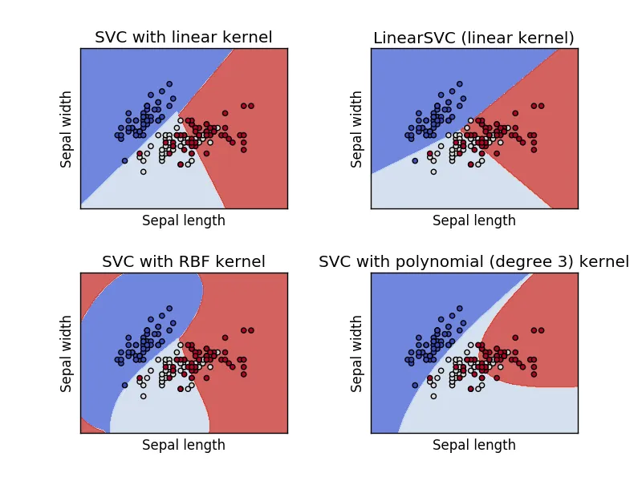

Slide 41
iris = datasets.load_iris()
X = iris.data[:, 2:] # we only take the last two features.
#loading the Petal features into X variabl
y = iris.target
C = 1.0 # SVM regularization parameter
# SVC with linear kernel
svc = svm.SVC(kernel='linear', C=C).fit(X, y)
# LinearSVC (linear kernel)
lin_svc = svm.LinearSVC(C=C).fit(X, y)
# SVC with RBF kernel
rbf_svc = svm.SVC(kernel='rbf', gamma=0.7, C=C).fit(X, y)
# SVC with polynomial (degree 3) kernel
poly_svc = svm.SVC(kernel='poly', degree=3, C=C).fit(X, y)
Give matrix of each model: Logistic, SVM and K-NN
IRIS, can be used
which work well?
SVM the best accuracy.
Polynomial and Sign are the best Kernels
and Plottings
EXAM 3

Slide 42
h = .02 # step size in the mesh
# create a mesh to plot in
x_min, x_max = X[:, 0].min() - 1, X[:, 0].max() + 1
y_min, y_max = X[:, 1].min() - 1, X[:, 1].max() + 1
xx, yy = np.meshgrid(np.arange(x_min, x_max, h),
np.arange(y_min, y_max, h))
# title for the plots
titles = ['SVC with linear kernel',
'LinearSVC (linear kernel)',
'SVC with RBF kernel',
'SVC with polynomial (degree 3) kernel']
for i, clf in enumerate((svc, lin_svc, rbf_svc, poly_svc)):
# Plot the decision boundary. For that, we will assign
# a color to each point in the mesh [x_min, x_max]x[y_min, y_max].
plt.subplot(2, 2, i + 1)
plt.subplots_adjust(wspace=0.4, hspace=0.4)
Z = clf.predict(np.c_[xx.ravel(), yy.ravel()])
# Put the result into a color plot
Z = Z.reshape(xx.shape)
plt.contourf(xx, yy, Z, cmap=plt.cm.coolwarm, alpha=0.8)
# Plot also the training points
plt.scatter(X[:, 0], X[:, 1], c=y, cmap=plt.cm.coolwarm)
plt.xlabel('Petal length')
plt.ylabel('Petal width')
plt.xlim(xx.min(), xx.max())
plt.ylim(yy.min(), yy.max())
plt.xticks(())
plt.yticks(())
plt.title(titles[i])
plt.show()

Slide 43
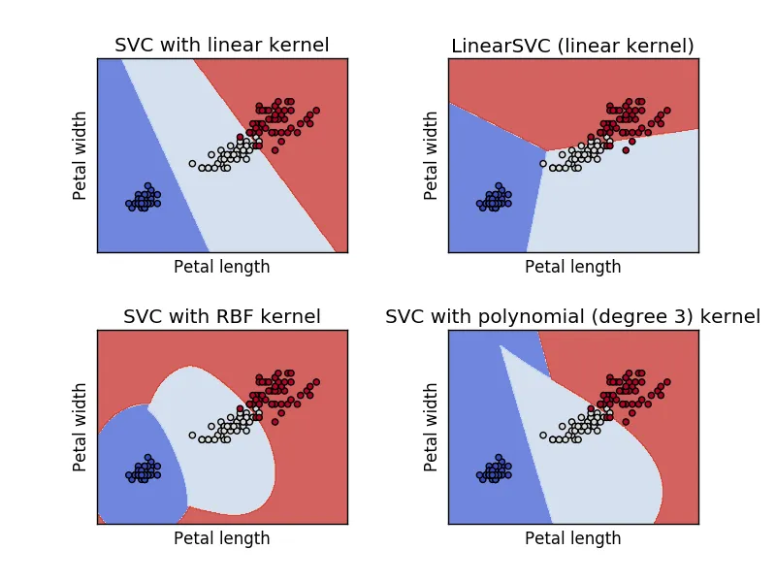
Disadvantage something kernel does not do well than linear

Slide 44
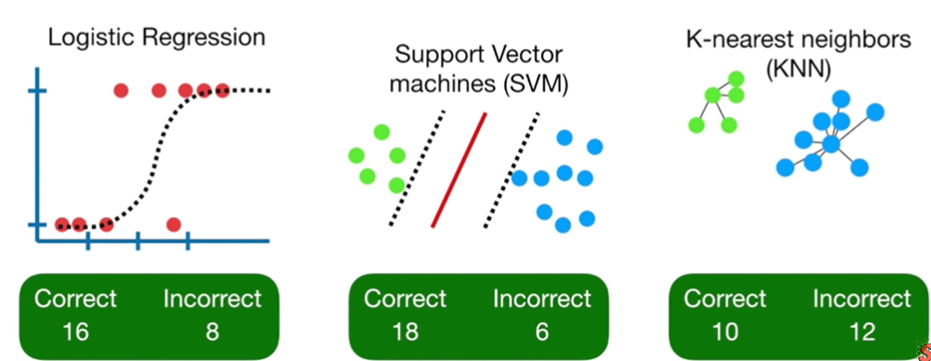
Which one is better?
KNN very slow and something can give accurate result. SMV is always the best classifier

Slide 45
Additional example(optional)

Slide 46
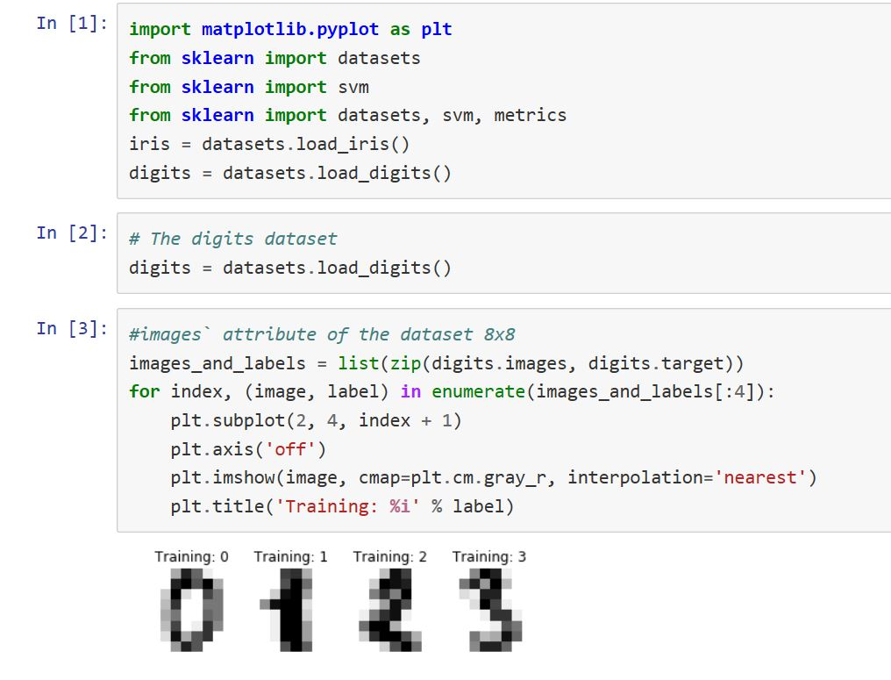
about using 2 SVM, like IRIS =datasets.load_iris

Slide 47
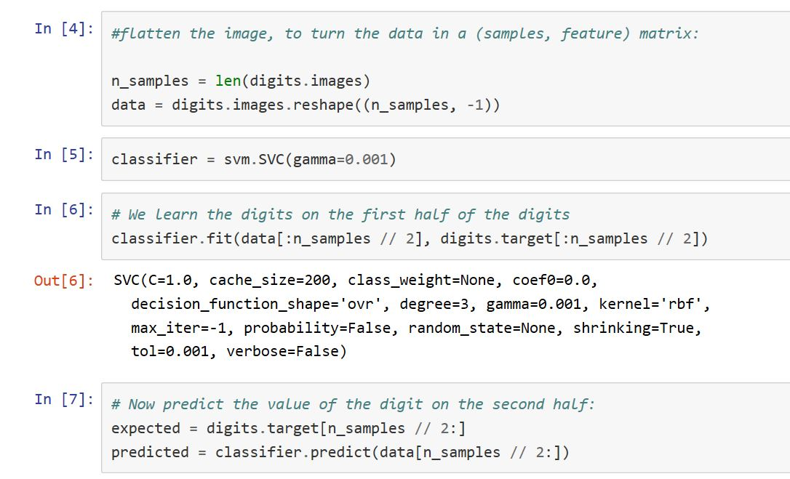

Slide 48
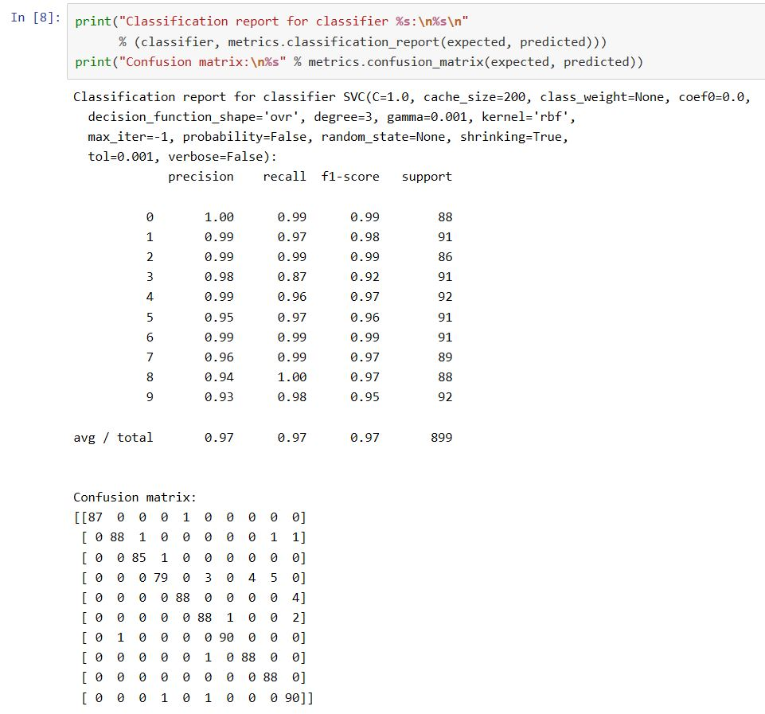
DO not forget Classification report. CHange C and Gamma

Slide 49
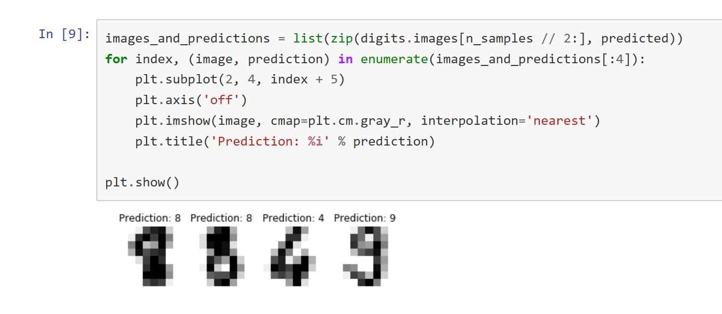
PLay with C, Gamma and Kernel to see better accuracy

